Slide 1
Nom Nom Safe
Anna Dinius
Owen Newberry
Pam Pepper
Jeffrey Perdue

Slide 2
Problem Statement
“Restaurants lack a centralized, user-friendly way to manage and communicate allergen-related menu information, leading to potential health risks for customers and inefficiencies for businesses.”

Slide 3
Development Plan
Sprint 1 (March 24 - April 6)
Frontend Development Only
Goal: Have all major UI components built and styled
Sprint 2 (April 7 - April 20)
Backend Development & Integration
Goal: Connect frontend to backend with MongoDB, implement business logic
Sprint 3 (April 21 - May 2)
Bug Fixes, Testing, Documentation
Goal: Have a full-stack application with proper documentation and testing ready for demonstration & submission

Slide 4
Rules
No Surprises
Divide and Conquer
Start early and finish early
Buy, don’t build
Comment your code
Provide descriptions for functions
Provide clarification as necessary
CC all team members on emails to the professor regarding the project.
One person will take notes of what is discussed in a meeting for those who are not there.
The note-taker for the meeting should be available to make time to answer questions for those who could not make it.
Penalty in the form of low peer review points when anyone breaks the team rules.

Slide 5
Tools
Front-end:
HTML
CSS
JS/JSX
React
Back-end:
Nodejs
Mongoose
Express
Database:
MongoDB
Documentation:
Notion
Canvas
Google Docs
Git/GitHub
Communication:
Microsoft Teams
IDE:
Visual Studio Code

Slide 6
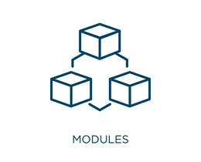
Modules
Authentication
Setup
Business
Menu
Menu Items
Admin
Testing

Slide 7

Use Case Diagram
NomNom Safe
User Promotion/ Demotion
Account Management
Edit Business Information
Administrator
Menu Management
Menu Item Management
Authentication
Business Management
Authorized User
Allergen Tagging
Account Creation
Business Creation
New User

Slide 8
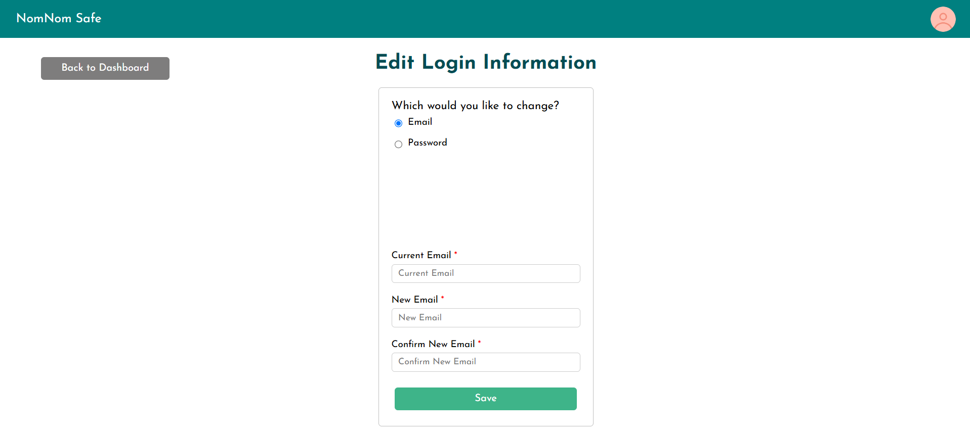
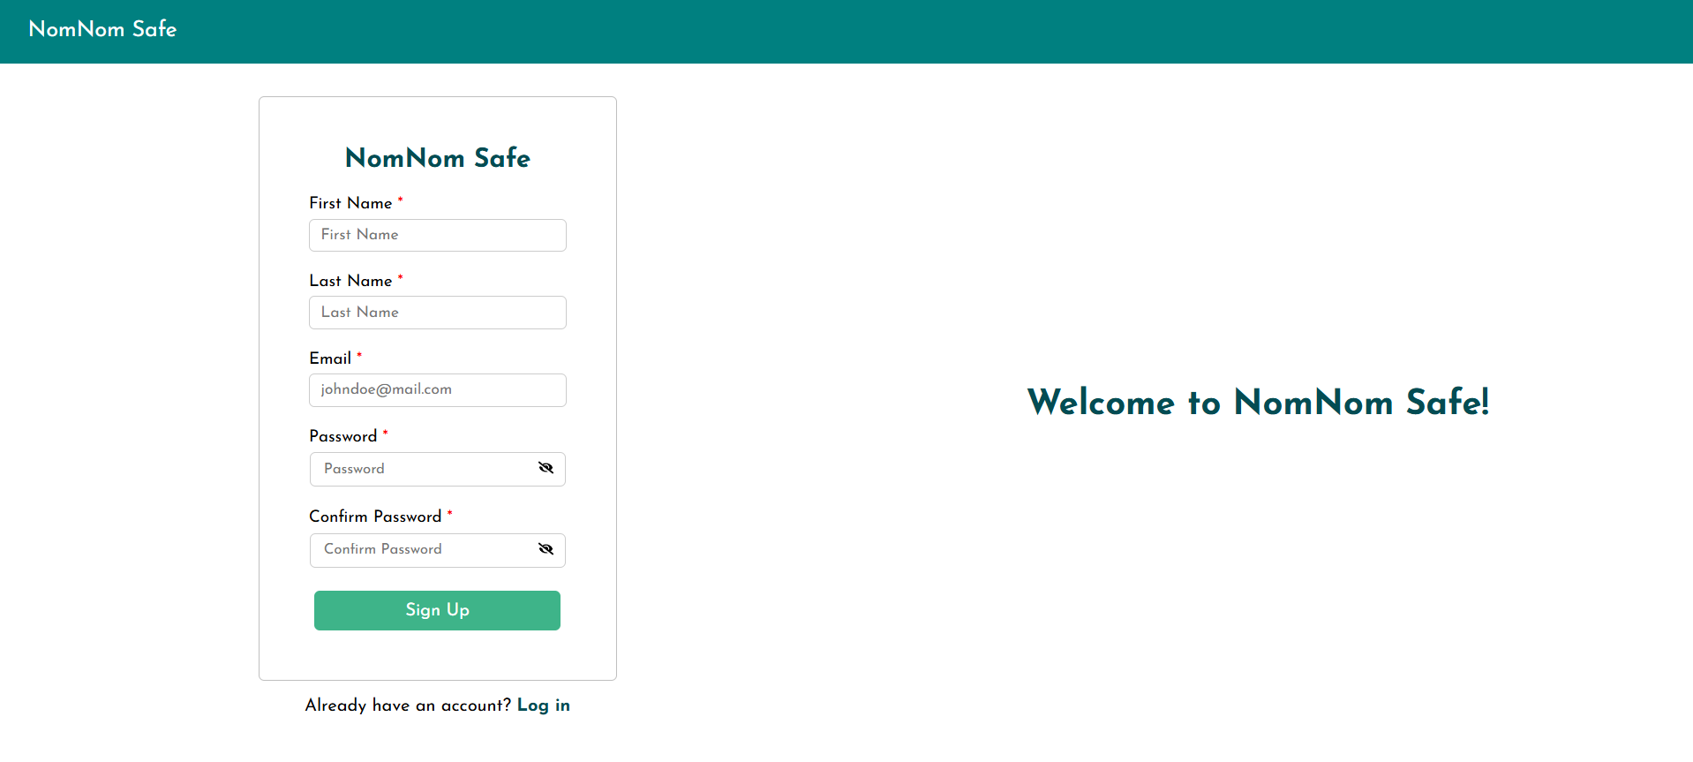
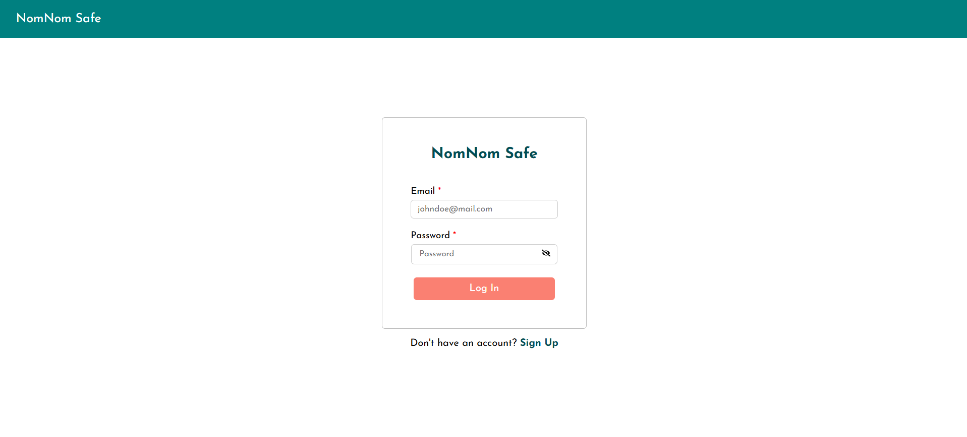
Authentication Module
Purpose
User login
User sign up
Credential management

Slide 9










Authentication Module - Error Handling with UI Feedback
Custom error and confirmation messages

Slide 10
Setup Module
Purpose: Guides users through business creation and initial configuration in a 3-step wizard (or alternatively being added to an existing business)
User chooses to create new business or be added to existing business
If new user, prompted for basic business information (Step 1)
Then asked for unavoidable allergens and special diet accommodations (Step 2)
Then asked preferred menu item layout (Step 3)
Then directed to Menu Dashboard

Slide 11
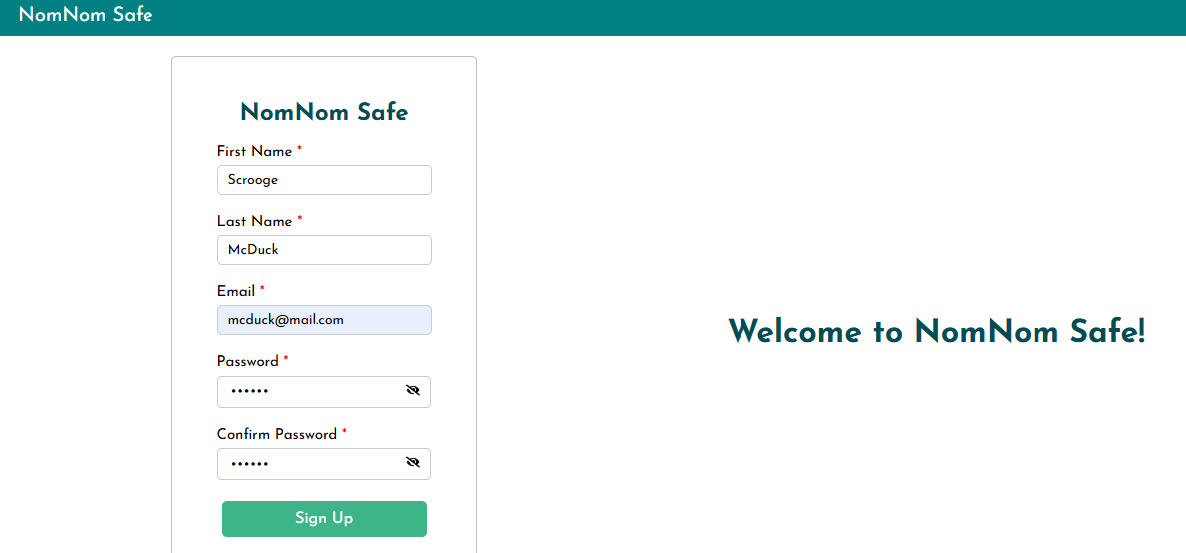
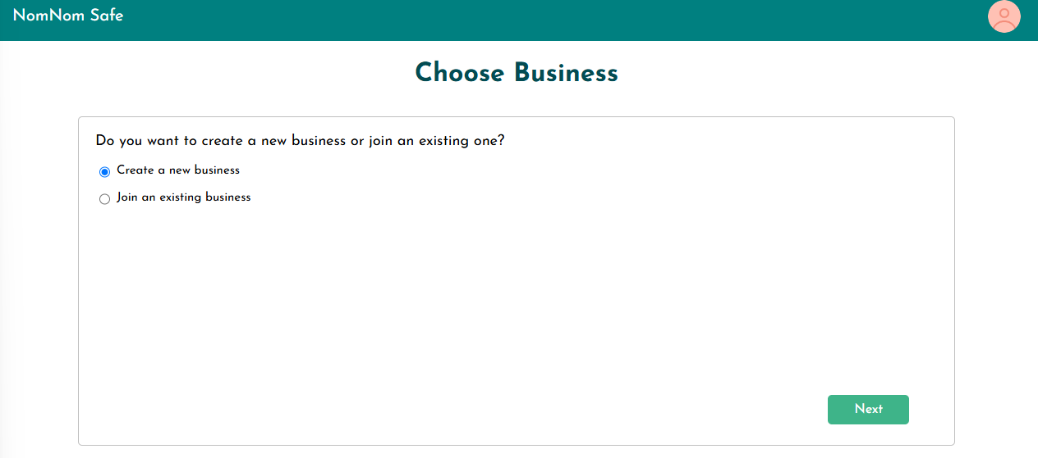
1.
2.

Slide 12
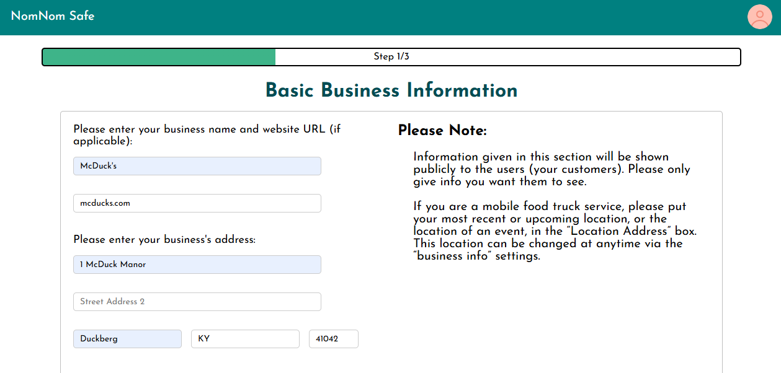
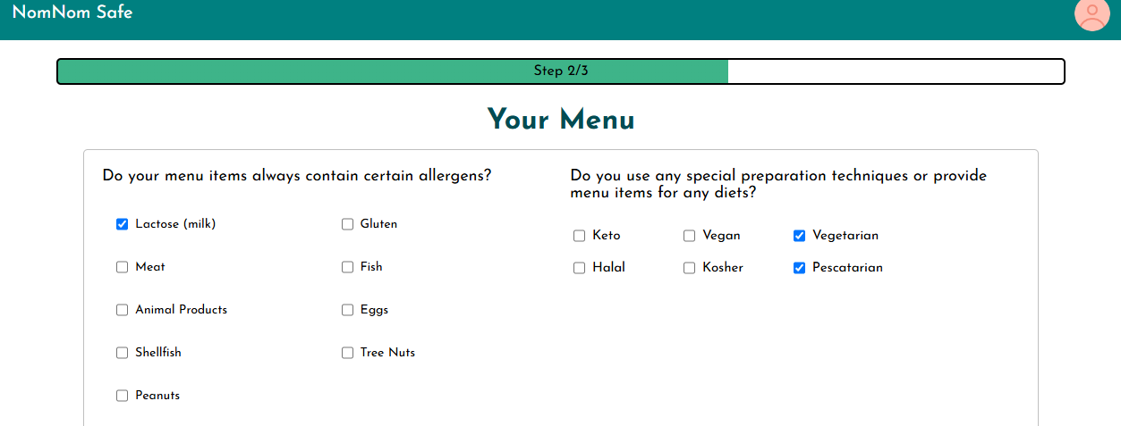
3.
4.

Slide 13
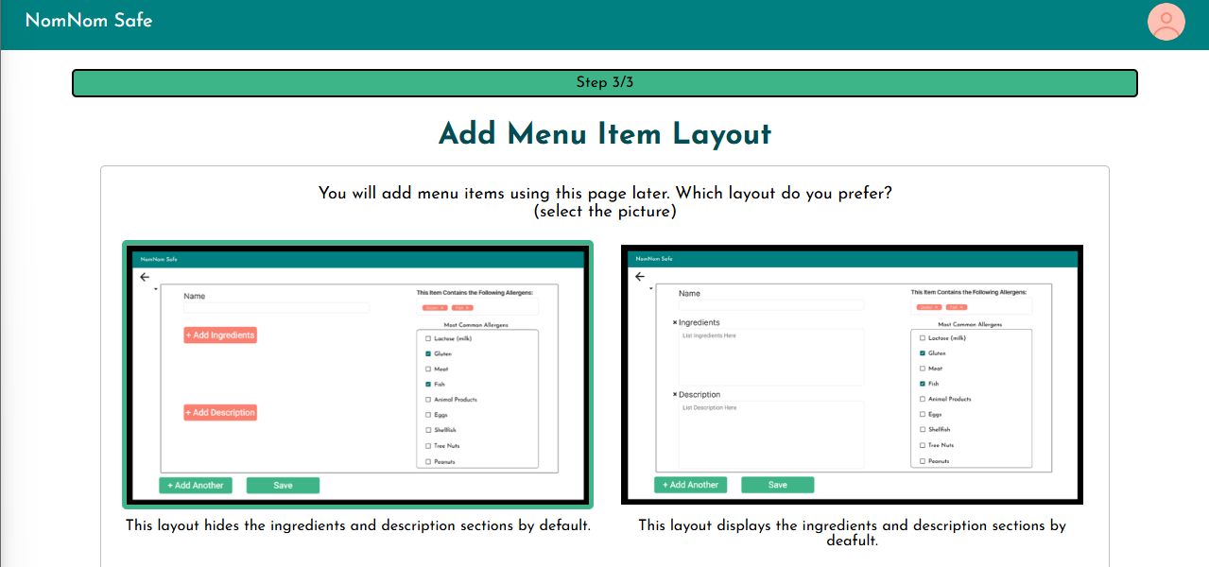
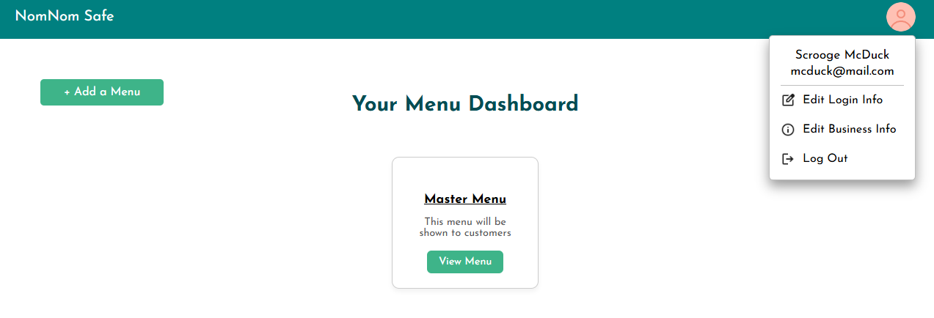
5.
6.

Slide 14
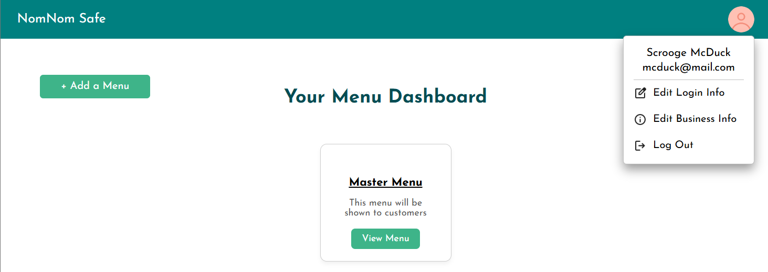
Business Module
Purpose: Manages business profile information and settings

Slide 15
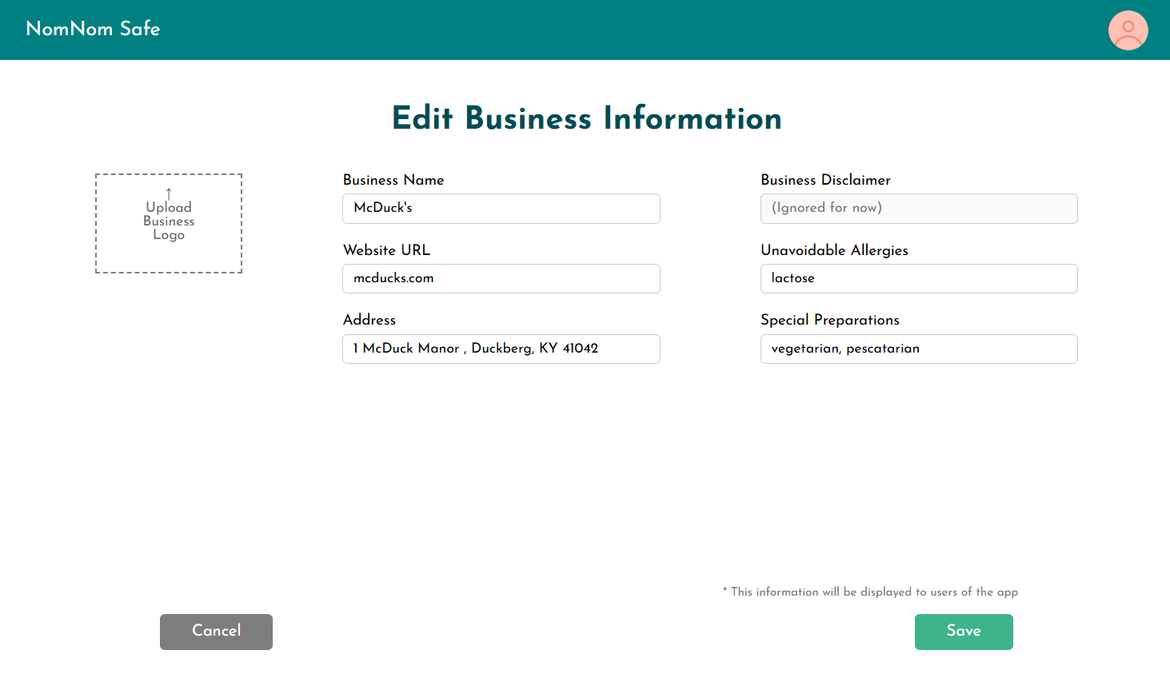

Slide 16
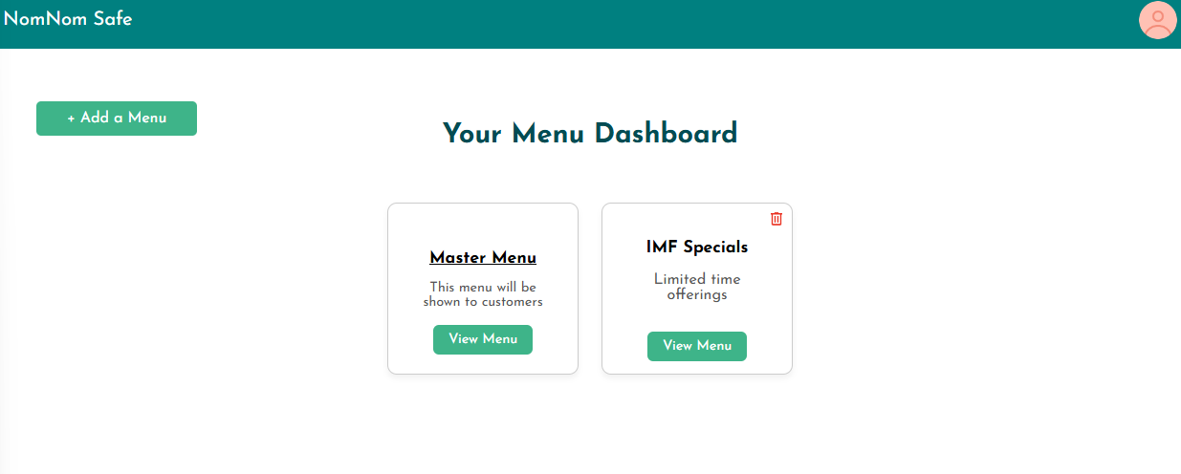
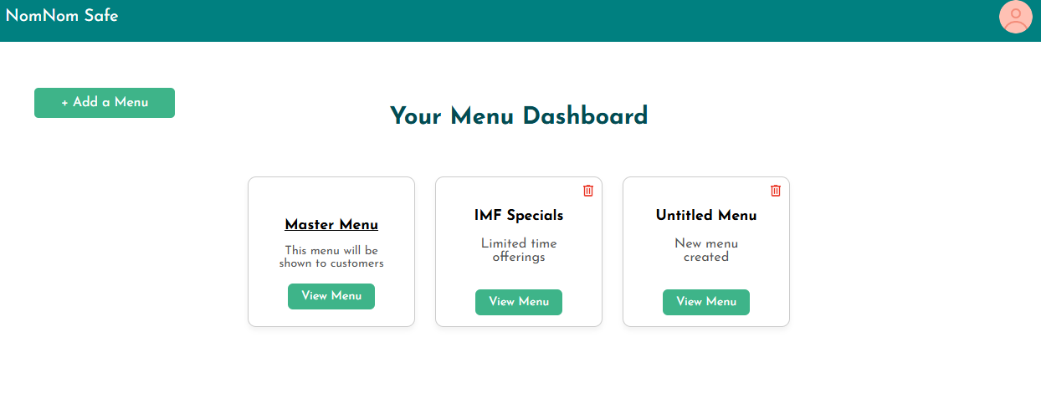
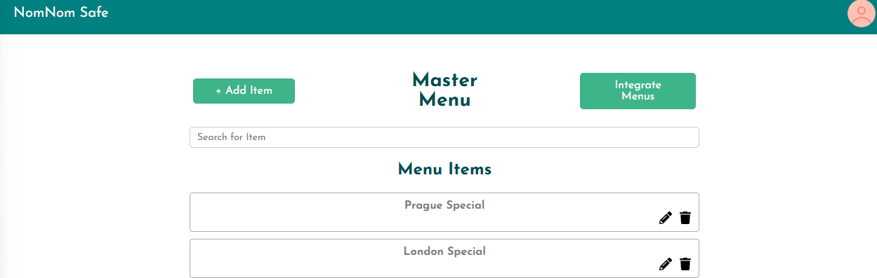
Menu Module
Purpose: Handles menu management, including:
Creating Menus
Editing Menus
Deleting Menus
Viewing Menus & navigating to Menu Items

Slide 17
Menu Items Module
Purpose: Handles adding menu items, editing, and adding them to different menus
Add Menu Item
Menu Items Page
Menu Item Swap
Implementation:
Custom Assets: Checkbox, Menu Item Pages
Schema
Routes

Slide 18
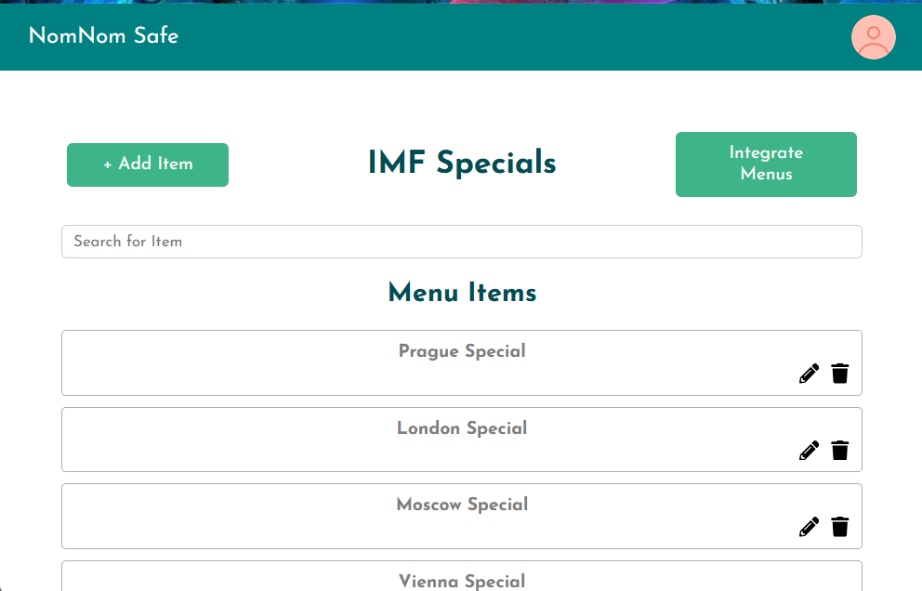
Menu Items Page
Allows user to view the items on particular menu
Allows editing of the items
Allows removing item from the menu

Slide 19
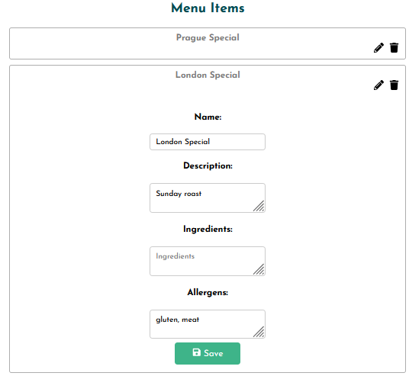
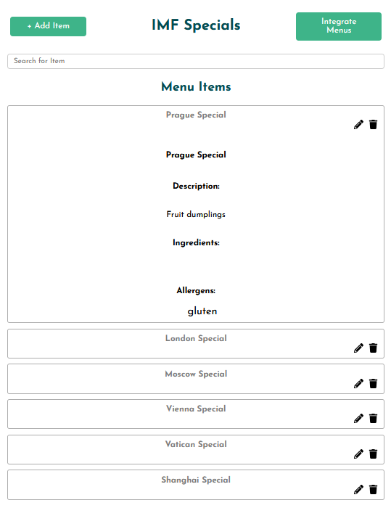
Menu Items Page

Slide 20
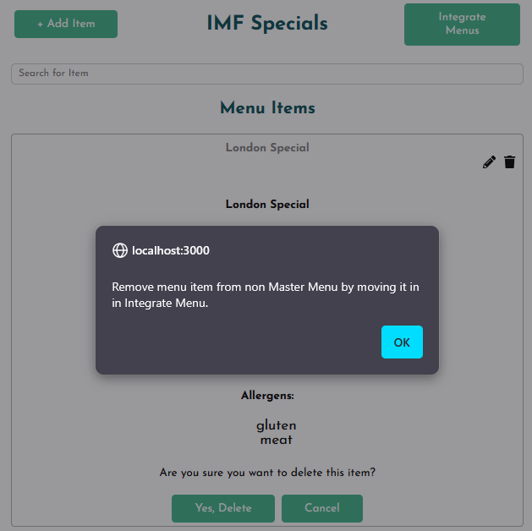
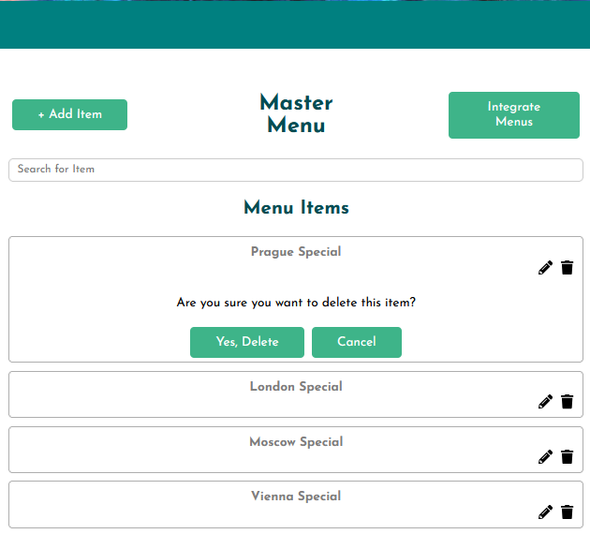
Menu Items Page

Slide 21
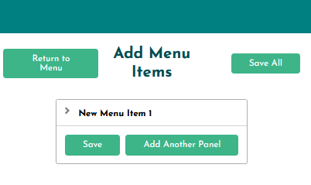
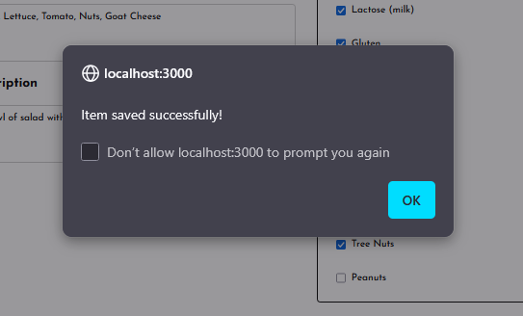

Add Menu Items
Allows the user to add menu items
All menu items automatically added to Master Menu in addition to specific parent menu
Allows user to safely add multiple menu items at once

Slide 22
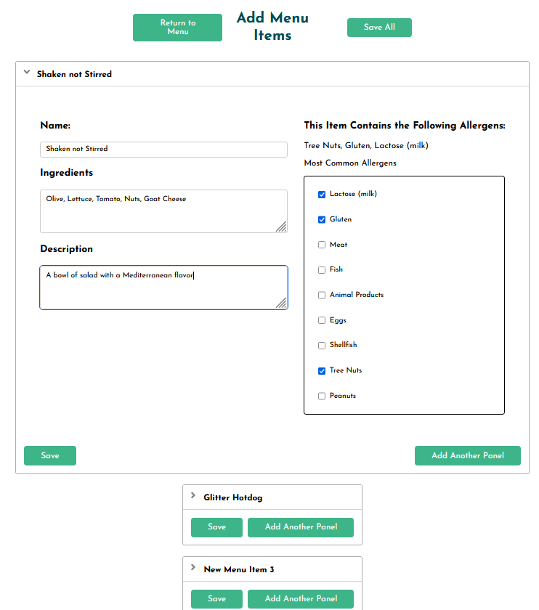
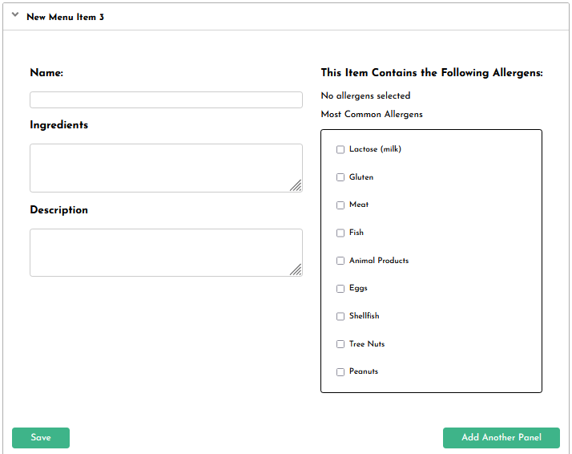
Add Menu Items

Slide 23
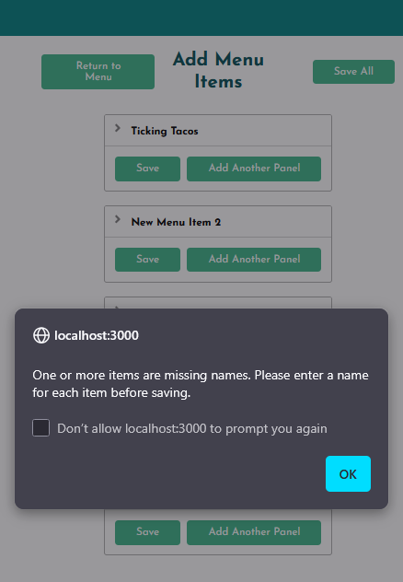
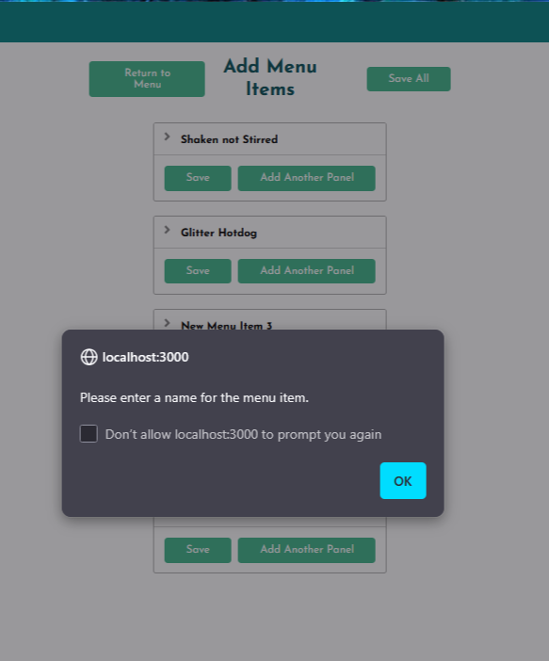
Add Menu Items

Slide 24
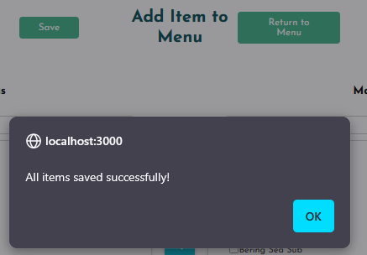
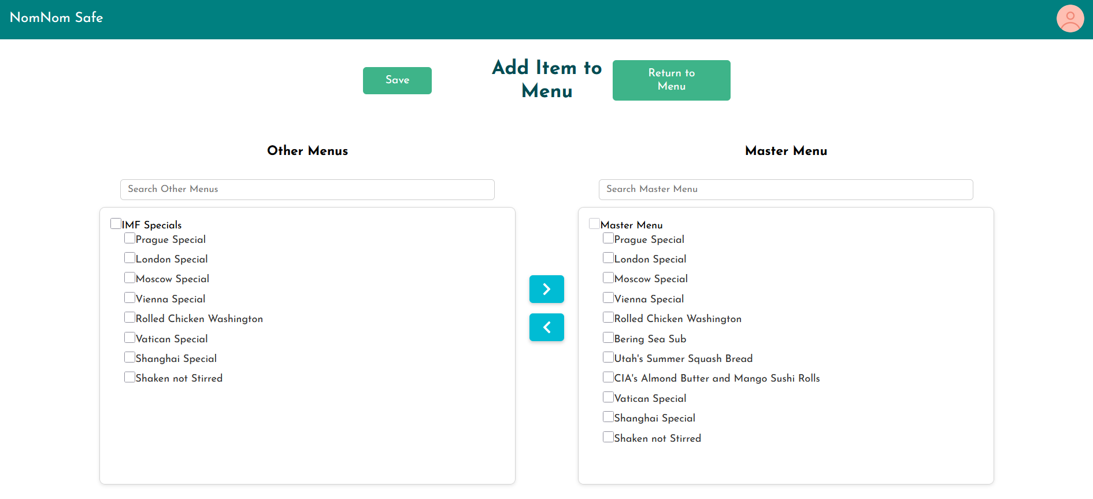

Menu Item Swap
Allows the user to smoothly add or remove menu items from menus
Can handle updating lots of menus at once
User forgiveness with moving items

Slide 25
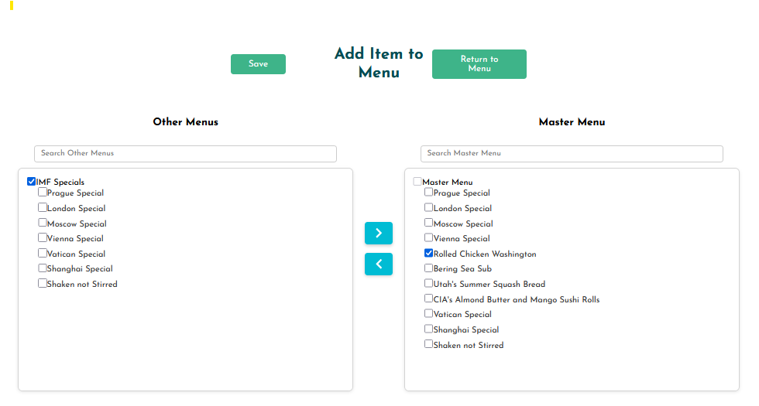
Menu Item Swap

Slide 26
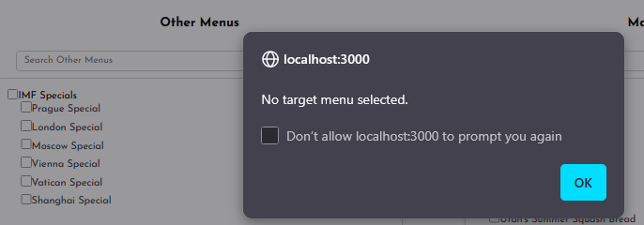
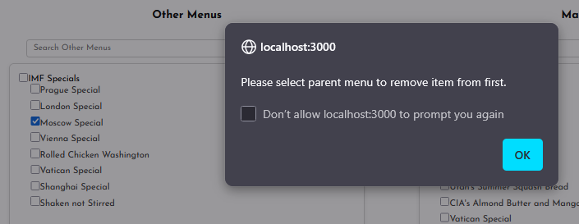
Menu Item Swap

Slide 27
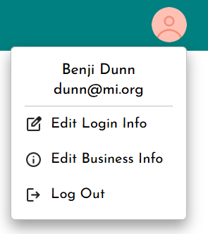
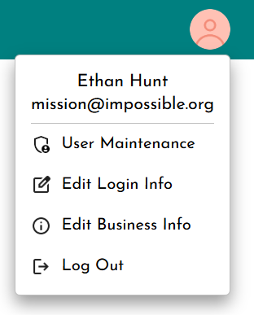
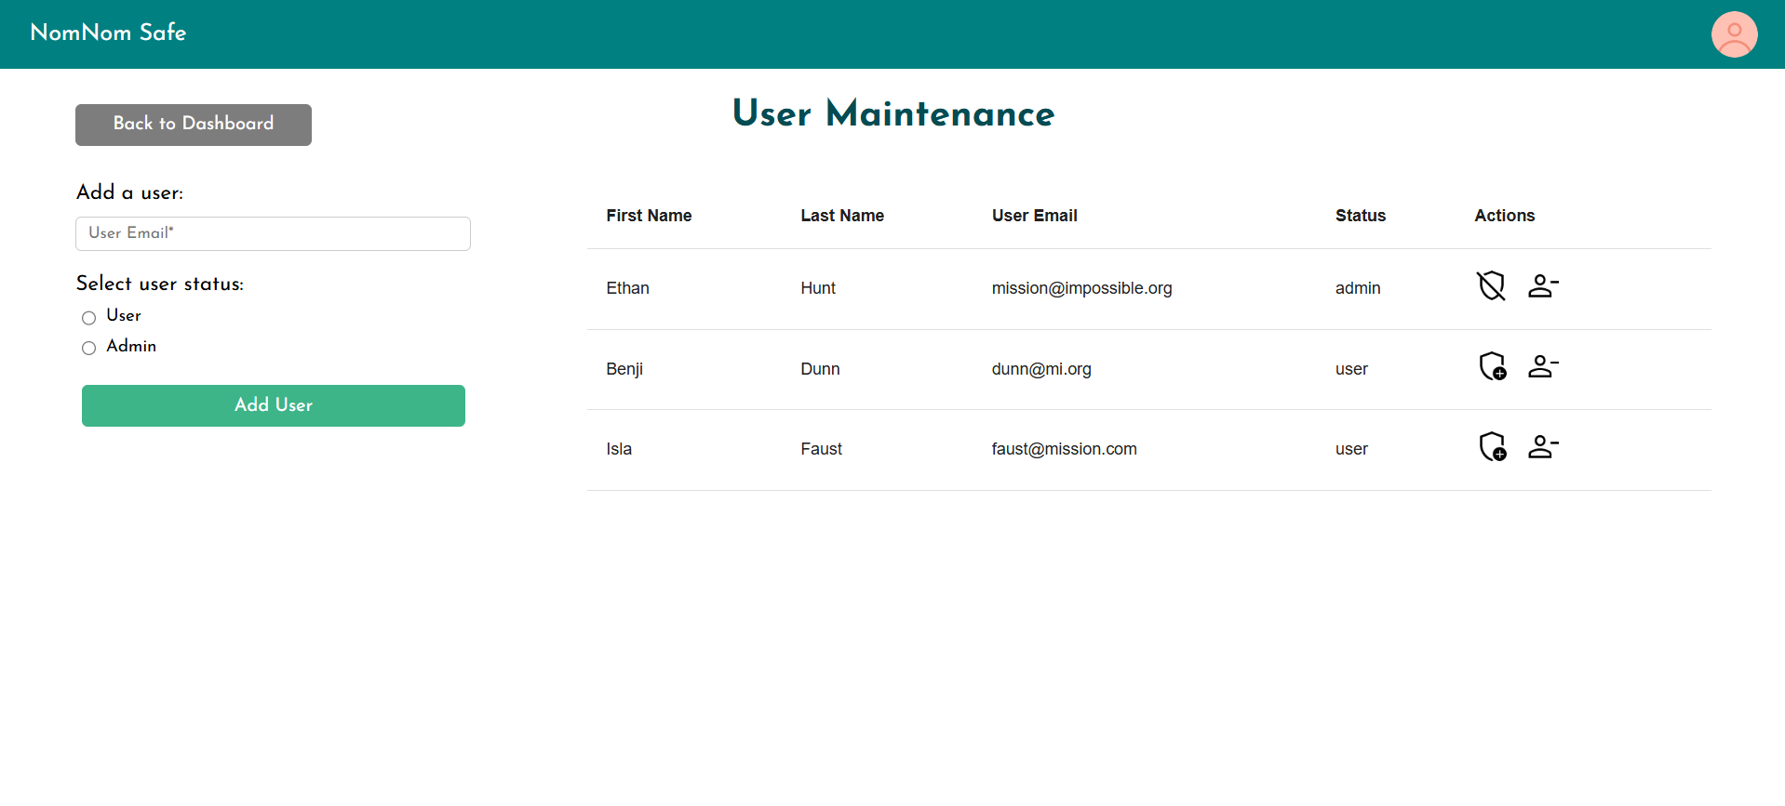
Admin Module
Purpose
Allows an admin to manage which users have access to the business
Actions:
Promote users to admins
Demote admins to users
Revoke user/admin access
Give access to an existing user

Slide 28




Admin Module - Error Handling with UI Feedback
Custom error and confirmation messages

Slide 29

Demonstration

